Slide 1
Bell Work: Graph 1.) 4y – 3x < 12 2.) y = –2|x+5|+6

Slide 2
ALGEBRA 3
Day 21

Slide 3
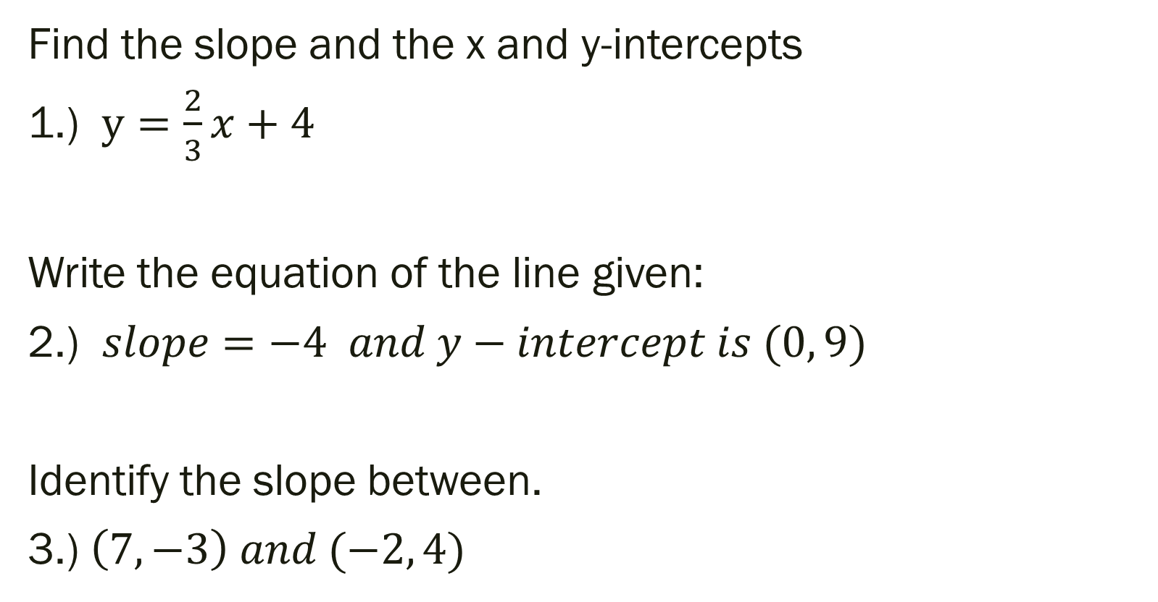
Unit 2 Quiz 1 Level 2
Find the slope and the x and y-intercepts
1.) $y=\frac{2}{3}x+4$
Write the equation of the line given:
2.) $slope=−4 and y−intercept is (0, 9)$
Identify the slope between.
3.) $\left(7, −3\right) and (−2, 4)$

Slide 4
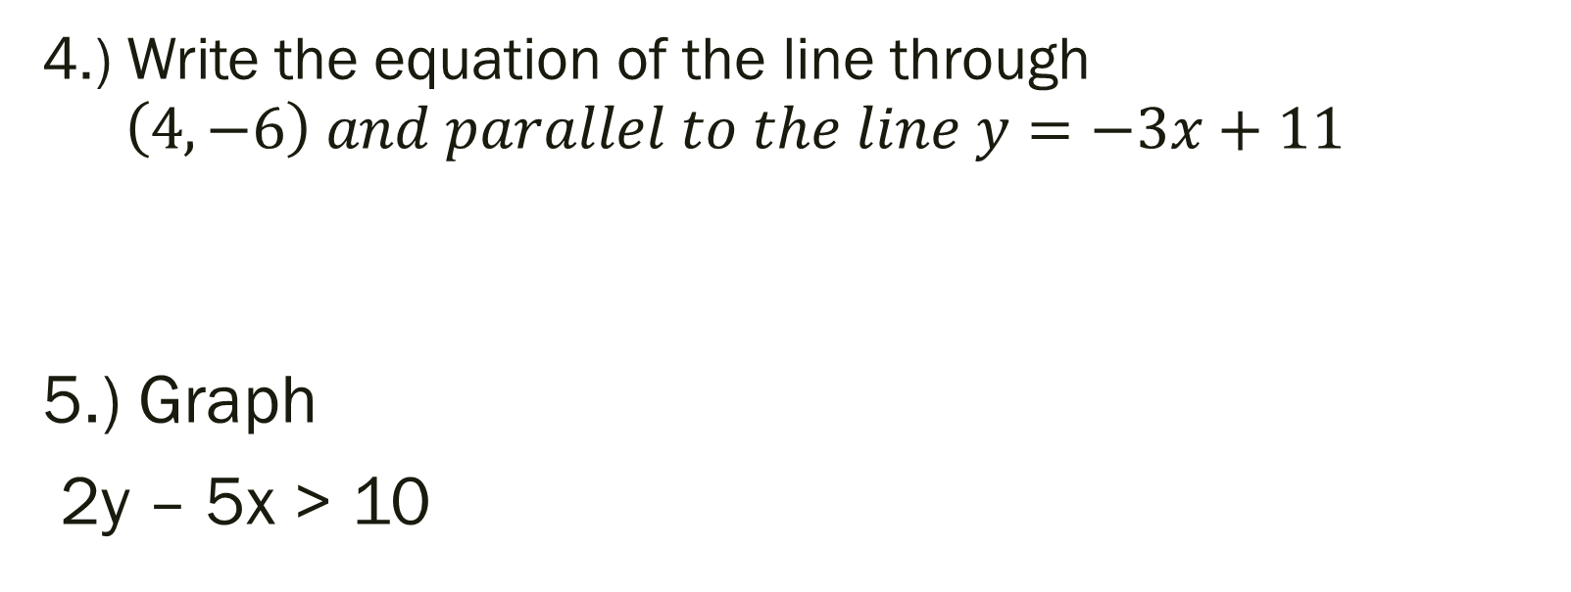
Unit 2 Quiz 1 Level 3
4.) Write the equation of the line through $\left(4, −6\right) and parallel to the line y=−3x+11$
5.) Graph
2y – 5x > 10

Slide 5
Unit 2 Quiz 1 Level 4
At a school concert, student tickets cost $3 each and adult tickets cost $7 each. The total amount of money earned from ticket sales the first night was $210.
6a.) Write an equation that represents this situation.
6b.) If you know 12 adults were in attendance, how many students went? Show your work from 6a.)

Slide 6
From Last Time…
New Material
Page 118 #1, 2, 11, 13, 15, 31, 41
Mixed Review
Page 120 #58, 61, 70

Slide 7
Things to Study
Domain and Range – Is it a function?
Find the slope (given y=mx+b, ax+by=c, or two points)
Given points, write equation as y=mx+b if a line
Write equation of line (given slope and point or two points)
Graph and describe transformation of quadratic
Graph and describe transformation of absolute value
Write equation and solve a story problem

Slide 8
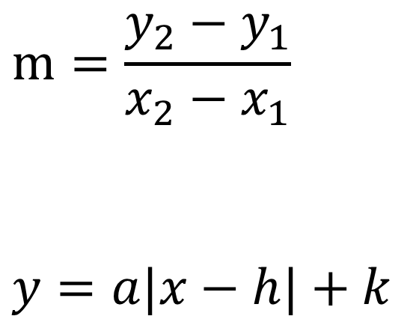
Equations I’ll leave on board for Test
$$m=\frac{y_{2}−y_{1}}{x_{2}−x_{1}}$$
$$y=a|x−h|+k$$
$$y=mx+b$$
$${y−y}_{1}=m\left(x−x_{1}\right)$$

Slide 9
Review Assignment (optional… pick the problems you need to review most)
Pg 123 #3-8, 16-31, 34-54
Similar problems on page 127 if you need more examples with answers in back of book

